Slide 1
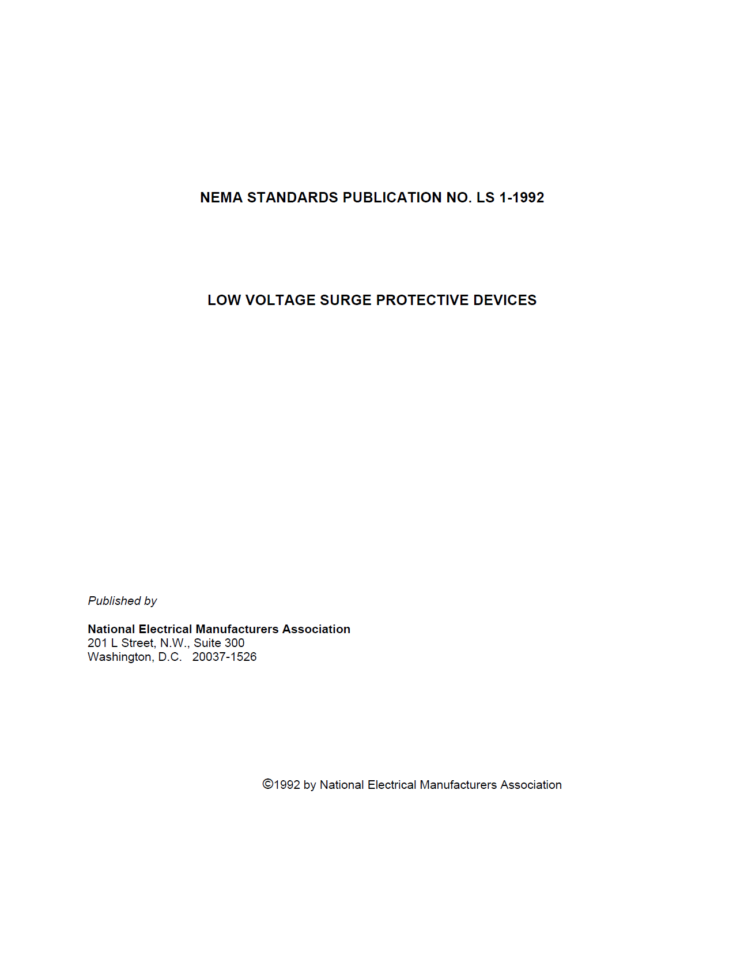
The need for uniformity in a growing industry
In the late 1980s and early 90s, the transient voltage surge suppression industry was experiencing the growth pains of a previously unregulated industry. UL had just introduced their UL 1449 Standard in 1985. And while manufacturers were beginning to enjoy the benefits of a growth industry, everyone with a different way to present the information on their product(s).
To bring a sense of consistency to the industry, the manufacturers used the vehicle of the NEMA Surge Protection group to produce a specification format.
This document represents the collective view of the Technical Committee of NEMA’s Low Voltage Surge Protective Section. It is intended to serve primarily as a guide to manufacturers and others affiliated with the Low Voltage SPD marketplace in the hope of uniformity of specifications, in terms of valid, understandable physical parameters, will improve the understanding of SPD literature.
NEMA LS 1-1992, Foreward

Slide 2
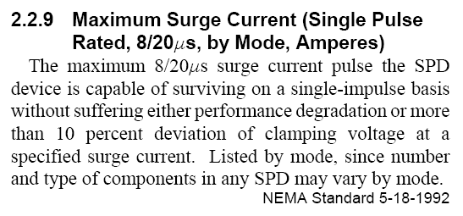
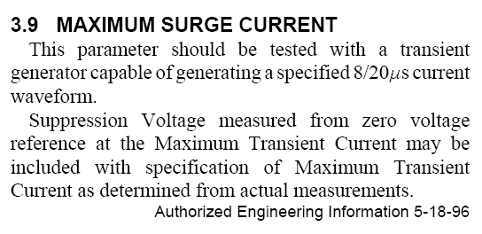
NEMA LS1-1992
Surge current listing is the maximum pulse the SPD is capable of surviving.
Surge current is to be a tested value.

Slide 3
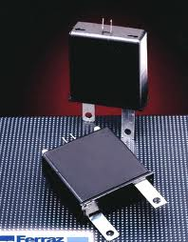
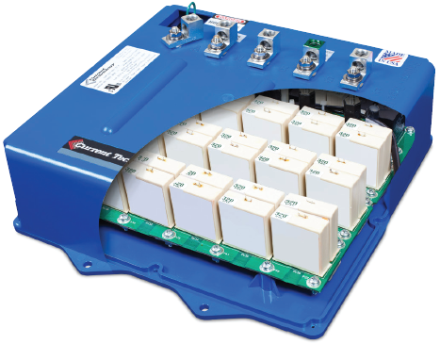
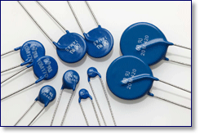
Presence of SPDs brought new realizations
Almost all manufacturers use Metal Oxide Varistors (MOVs) in their surge protection devices. The industry and industry practices were getting a lot of attention and that yielded some unanticipated results.
MOVs are available for a wide range of voltages and currents, for peak pulse currents from only a few amperes up to tens of thousands of amperes. They are low in cost, compact in size, easy to apply, and are among the most frequently used devices for transient protection. One disadvantage is that their characteristics deteriorate with repeated transients. Although this problem is being reduced with improved technology, MOV life under frequent transient conditions must be considered.
EC&M Practical Guide to Quality Power for Sensitive Electronic Equipment, Page 42, Paragraph 2.

Slide 4
What happens when an SPD fails
Everyone knew about the degradation and failure of MOVs, but there was a more catastrophic aspect of that failure than originally considered. The impact of SPDs and their failures in and on the electrical distribution system began to gain the critical attention it required.
When metal oxide varistors reach an end-of-life condition, they … initiate a conductive condition identified as thermal runaway that inevitably results in the destruction of the MOV. The resulting destruction of the MOV might expel hot metal fragments, conductive ionized gases, and dense conductive smoke and soot. In addition to immediate hazards, the introduction of such materials into the interior of electrical distribution equipment can damage or compromise an insulation system and result in a cascading effect and serious equipment damage.
IEEE PC62.72-2007, August 3, 2007, Page 30

Slide 5
Striving for solutions
So even as the time had arrived that the use of SPDs was becoming recognized as vital for the protection of burgeoning electronic distribution and process systems, manufacturers began grappling with ways to mitigate effects of their failure.
Thermal runaway conditions are extremely destructive and SPD manufacturers attempt to mitigate these conditions by using a variety of means. Commons methods employed to reduce the effect of SPD thermal runaway conditions are as follows:
Enclosure of SPD within suitable enclosures.
Encasement of the metal oxide varistor arrays within appropriate sealing compound or sand, or both.
The use of integral or external overcurrent protective device.
The use of integral thermal, cut-off devices as fuse links, solder wire, or thermal squibs.
Avoid or limit the use of flammable materials in the enclosure.
Any combination of any or all of the above.
IEEE PC62.72-2007, August 3, 2007, Page 30
All of these options were considered for the inevitable, though possibly rare, deleterious effects of the failure of SPD components. But a universal solution to the problem was sought.

Slide 6
UL to the Rescue
Rather than necessitating a solution to affected components which experience the “slow burn” or “thermal runaway”, that could interfere with the effective designed performance capabilities of SPDs, UL 1449 Third Edition implemented new requirements.
39.3 Intermediate current test
39.3.1 One representative device of the SPD, for each conductor pair tested in accordance with the VPR Test (6 kV/3 kA combination wave) … , is to be subjected to the application of the test voltage as specified in Table 39.1. The ac power source shall have an available short-circuit (fault) current (Isc) as specified in Table 39.4.
UL 1449 Third Edition, June 1, 2009, Page 86

Slide 7
Question:
How does this relate to surge current?
Well,
UL’s solution was to preclude SPD components from being exposed to the type of event that would otherwise cause them to experience thermal runaway.
BUS
SPD
39.3.2 For each representative device, the overvoltage is to be applied for 7 hours, or until the SPD becomes disconnected from the ac supply (due, for example, to open circuiting of a thermal or overcurrent protective device).
UL 1449 Third Edition, June 1, 2009, Page 86
BUS
SPD
At the instant MOVs begin to conduct what the response characteristics of the OPDs (aka fuse links) determine as initiating the progression to thermal runaway, the fuse links disconnect the SPD. The SPD components cannot fail castrophically, as they are disconnected from the circuit.

Slide 8
How this relates to surge current (capacity)
Manufacturers discovered, to their chagrin, that an OCP mechanism sized properly for a given surge current capacity, as required by UL to provide protection from thermal runaway for SPD components, also, opens circuits during surges in their extant SPD designs at approximately two thirds of the full surge current capacity to which the arithmetic sum of the rating of components calculated.
BUS
SPD
Manufacturers had to decide to pursue one of three different options.
Modify and test their design to allow surge currents at capacities of the full arithmetic sum of the rating of components to pass through the circuit the OCP mechanism opening the circuit. The surge current capacity would be a tested value, consistent with the requirements of NEMA LS-1-1992.
Test the surge current capacity that a given arithmetic summation of the rating of components could pass without degradation of performance, and rate the SPD accordingly.
Use the arithmetic sum of the rating of components as the surge current rating.
BUS
SPD
What happened next is instructive.

Slide 9
Following a crowd is not always best, or right
The AIA MasterSpec now includes the following; Section 26 43 13, Surge Protection Devices:
“The peak surge current rating shall be the arithmetic sum of the ratings of the individual MOVs in a given mode.”
So while most manufacturers now give their surge current rating as an arithmetic sum, Current Technology continues to establish and confirm their surge current ratings by testing.
By the way, do you know what the IEEE says about this?
Testing of the SPD to a standard to determine the surge current rating is paramount.
IEEE PC62.72-2007, August 3, 2007, Page 28
We continue to provide the best and most reliable SPDs available and don’t take short cuts.

